Slide 1
“Teach A Level Maths”
Statistics 1
Cumulative Frequency Diagrams
© Christine Crisp

Slide 2
Statistics 1
AQA
EDEXCEL
MEI/OCR
OCR
"Certain images and/or photos on this presentation are the copyrighted property of JupiterImages and are being used with permission under license. These images and/or photos may not be copied or downloaded without permission from JupiterImages"

Slide 3
A stem and leaf diagram is used to show simple raw data which can be written out as a list of values.
In most cases, however, data will have been grouped into classes and a frequency given for each class.
Grouped frequency data can be displayed in a cumulative frequency diagram.

Slide 4
e.g. The projected population of the U.K. for 2005, by age:
AGE
Freq
Cu.F
( years )
(millions)
(millions)
0 – 9
7
7
10 – 19
8
15
20 – 29
7
22
30 – 39
9
31
40 – 49
9
40
Why does this appear as 0?
50 – 59
8
48
60 – 69
6
54
ANS: The data are given to the nearest million. The projected figure was 113,000.
70 – 79
4
58
80 – 89
2
60
90+
0
60
In drawing the diagram I shall miss out this group.
Source: USA IDB

Slide 5
e.g. The projected population of the U.K. for 2005, by age:
AGE
Freq
Cu.F
Points to notice:
( years )
(millions)
(millions)
There is no gap between 9 and 10 as the data are continuous.
0 – 9
7
7
10 – 19
8
15
20 – 29
7
22
Points are plotted at upper class boundaries (u.c.bs.)
30 – 39
9
31
40 – 49
9
40
e.g. the u.c.b. for 0 − 9 would normally be 9·5
50 – 59
8
48
60 – 69
6
54
70 – 79
4
58
80 – 89
2
60
Source: USA IDB

Slide 6
e.g. The projected population of the U.K. for 2005, by age:
AGE
Freq
Cu.F
Points to notice:
( years )
(millions)
(millions)
There is no gap between 9 and 10 as the data are continuous.
0 – 9
7
7
10 – 19
8
15
20 – 29
7
22
Points are plotted at upper class boundaries (u.c.bs.)
30 – 39
9
31
40 – 49
9
40
e.g. the u.c.b. for 0 − 9 would normally be 9·5
50 – 59
8
48
60 – 69
6
54
70 – 79
4
58
Age data have different u.c.bs. Can you say why this is?
80 – 89
2
60
ANS: If I ask children their ages, they reply 9 even if they are nearly 10, so, the 0-9 group contains children right up to age 10 NOT just nine and a half.
Source: USA IDB

Slide 7
e.g. The projected population of the U.K. for 2005, by age:
AGE
Freq
Cu.F
Points to notice:
( years )
(millions)
(millions)
There is no gap between 9 and 10 as the data are continuous.
0 – 9
7
7
10 – 19
8
15
20 – 29
7
22
Points are plotted at upper class boundaries (u.c.bs.)
30 – 39
9
31
40 – 49
9
40
e.g. the u.c.b. for 0 − 9 would normally be 9·5
50 – 59
8
48
60 – 69
6
54
70 – 79
4
58
80 – 89
2
60
The u.c.bs. for this data set are 10, 20, 30, . . .
Source: USA IDB

Slide 8
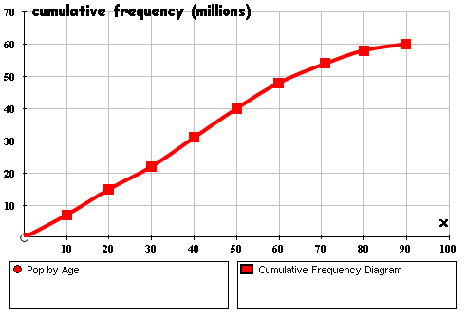

e.g. The projected population of the U.K. for 2005, by age:
AGE
f
Cu.f
u.c.b.
The projected population of the U.K. for 2005 ( by age )
( yrs )
(m)
(m)
( yrs )
0 – 9
7
7
10
10 – 19
8
15
20
20 – 29
7
22
30
30 – 39
9
31
40
40 – 49
9
40
50
Age (yrs)
50 – 59
8
48
60
60 – 69
6
54
70
The median age is estimated as the age corresponding to a cumulative frequency of 30 million.
70 – 79
4
58
80
On cumulative frequency diagrams it is correct to use to locate the median. This is because the points are plotted at u.c.bs. ( However, in practice it makes very little difference ).
80 – 89
2
60
90
Source: USA IDB
The median age is 39 years
( Half the population of the U.K. will be over 39 in 2005. )

Slide 9
e.g. The projected population of the U.K. for 2005, by age:
AGE
f
Cu.f
u.c.b.
The projected population of the U.K. for 2005 ( by age )
The projected population of the U.K. for 2005 ( by age )
( yrs )
(m)
(m)
( yrs )
0 – 9
7
7
10
10 – 19
8
15
20
20 – 29
7
22
30
30 – 39
9
31
40
40 – 49
9
40
50
Age (yrs)
50 – 59
8
48
60
60 – 69
6
54
70
The quartiles are found similarly:
70 – 79
4
58
80
80 – 89
2
60
90
lower quartile: 20 years
Source: USA IDB
upper quartile: 56 years
The interquartile range is 36 years

Slide 10
e.g. The projected population of the U.K. for 2005, by age:
AGE
f
Cu.f
u.c.b.
The projected population of the U.K. for 2005 ( by age )
( yrs )
(m)
(m)
( yrs )
0 – 9
7
7
10
10 – 19
8
15
20
51
20 – 29
7
22
30
30 – 39
9
31
40
40 – 49
9
40
50
Age (yrs)
50 – 59
8
48
60
60 – 69
6
54
70
If the retirement age were to be 65 for everyone, how many people would be retired?
70 – 79
4
58
80
80 – 89
2
60
90
Source: USA IDB
ANS: ( 60 – 51 ) million
= 9 million

Slide 11

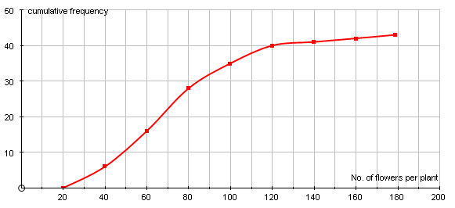
Exercise
The table and diagram show the number of flowers in a sample of 43 antirrhinum plants.
x
f
Cu.f
Number of flowers on antirrhinum plants
20-39
6
6
40-59
10
16
60-79
12
28
80-99
7
35
100-119
5
40
120-139
1
41
140-159
1
42
160-179
1
43
Source: O.N.Bishop
Estimate the median number of plants and the percentage of plants that have more than 90 flowers.

Slide 12
Solution:
x
f
Cu.f
Number of flowers on antirrhinum plants
20-39
6
6
40-59
10
16
60-79
12
28
32
80-99
7
35
100-119
5
40
120-139
1
41
140-159
1
42
160-179
1
43
There are 43 observations, so the median is given by the 21·5th one.
The u.c.bs. ( where we plot the points ) are at 39·5, 59·5 etc.
Median = 70
Number with more than 90 flowers =

Slide 13
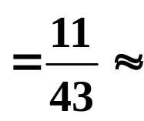
Solution:
x
f
Cu.f
Number of flowers on antirrhinum plants
20-39
6
6
40-59
10
16
60-79
12
28
32
80-99
7
35
100-119
5
40
120-139
1
41
140-159
1
42
160-179
1
43
There are 43 observations, so the median is given by the 21·5th one.
Median = 70
Number with more than 90 flowers =
43 – 32 = 11
Percentage with more than 90 flowers
26%

Slide 14
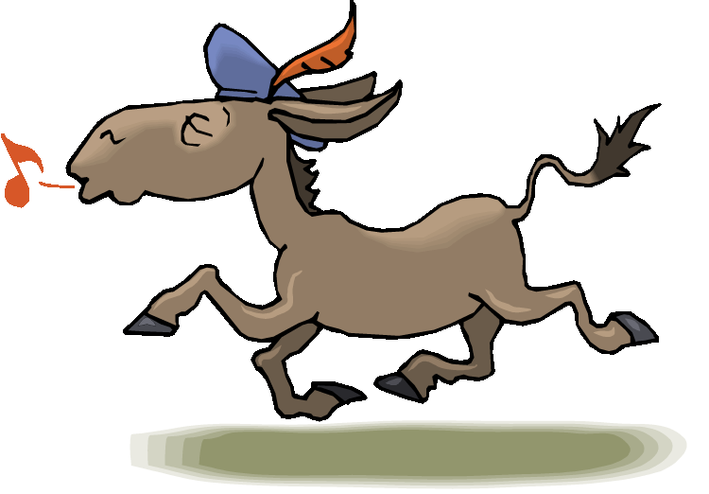

Slide 15
The following slides contain repeats of information on earlier slides, shown without colour, so that they can be printed and photocopied.
For most purposes the slides can be printed as “Handouts” with up to 6 slides per sheet.

Slide 16
This diagram is usually used for grouped data.
e.g. The projected population of the U.K. for 2005, by age:
AGE
Freq
Cu.F
Points to notice:
( years )
(millions)
(millions)
Data are plotted at upper class boundaries (u.c.bs.)
0 – 9
7
7
10 – 19
8
15
20 – 29
8
22
The u.c.b. for a group of age data is given by the lower limit shown for the next group.
( Here the u.c.bs. are 10, 20, 30, . . . ).
For all other data the u.c.b. is halfway between the limits given ( so at 9·5, 19·5, . . .)
30 – 39
9
31
40 – 49
9
40
50 – 59
8
48
60 – 69
6
54
70 – 79
4
58
80 – 89
2
60
Source: USA IDB

Slide 17
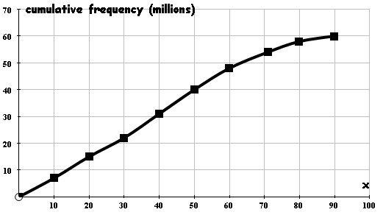
AGE
f
Cu.f
u.c.b.
( yrs )
(m)
(m)
( yrs )
0 – 9
7
7
10
10 – 19
8
15
20
20 – 29
8
22
30
30 – 39
9
31
40
40 – 49
9
40
50
50 – 59
8
48
60
60 – 69
6
54
70
The median age is given by the age corresponding to a cumulative frequency of 30 million.
70 – 79
4
58
80
80 – 89
2
60
90
Source: USA IDB
The median age is 39 years
( Half the population of the U.K. will be over 39 in 2005. )

Slide 18
AGE
f
Cu.f
u.c.b.
The projected population of the U.K. for 2005 ( by age )
( yrs )
(m)
(m)
( yrs )
0 – 9
7
7
10
10 – 19
8
15
20
20 – 29
8
22
30
30 – 39
9
31
40
40 – 49
9
40
50
50 – 59
8
48
60
60 – 69
6
54
70
The quartiles are found similarly:
70 – 79
4
58
80
80 – 89
2
60
90
lower quartile: 20 years
Source: USA IDB
upper quartile: 56 years
The interquartile range is 36 years

Slide 19
AGE
f
Cu.f
u.c.b.
( yrs )
(m)
(m)
( yrs )
0 – 9
7
7
10
10 – 19
8
15
20
51
20 – 29
8
22
30
30 – 39
9
31
40
40 – 49
9
40
50
50 – 59
8
48
60
60 – 69
6
54
70
If the retirement age were to be 65 for everyone, how many people would be retired?
70 – 79
4
58
80
80 – 89
2
60
90
Source: USA IDB
ANS: ( 60 – 51 ) million
= 9 million

